Slide 1

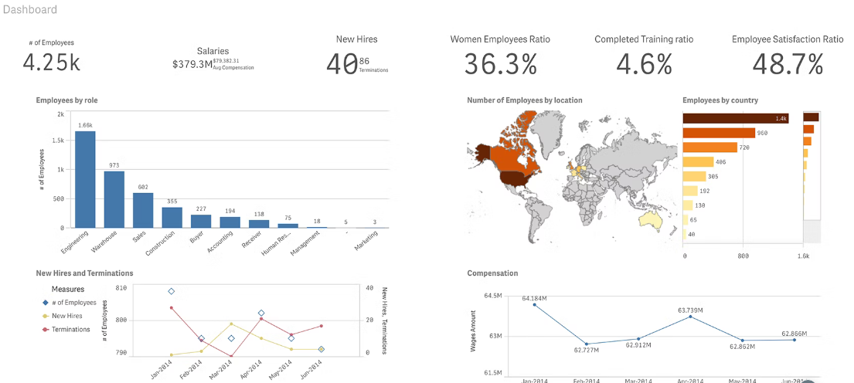
Challenge Statement: Develop Web-based Exploration tool for Human Resources data.
Group Name: BreakingData - 4099
Group Members:
Noah Raphael David Yuvaraja
Pallavi Menon
Akash Guje

Slide 2
Presentation Overview:-
Intro to Challenge
Process Flow
Data Collection
Data Cleaning
Explore the Data with Tableau
Dashboard Overview.

Slide 3
Intro To Challenge:-
We developed a interactive dashboards to display the metrics of the employment sector based on the Province and Application Month.
Any HR employee without any experience in Data analysis part can easily understand the employment metrics using this dashboards
Applicants Overview Dashboard
Applicants Count by Province,Equity Group and First language
Avg Salary By Job Type
Average Salary across Organizations based on Job Type

Slide 4
PROCESS FLOW
1
2
3
4
Data Collection
Data Cleaning
Data Analysis
Dashboard Creation

Slide 5
Data Collection
We were provided with the employment information of 6 Organizations in Canada. Along with this we have separate columns for the Employment Group,Province, Equity Groups(Indigeneous,Minority,Disabled) , Application Date and Salaries.
This Data consists the information of 30620 Employees working in the 6 Organizations.

Slide 6
DATA CLEANING
In order to deliver the accurate metrics we need a data which is clean and true. To achieve this we performed below DATA CLEANING process.
After the process we found out that there was no missing data or duplicate records and stage is set of data analysis.
Check for missing Values
Check of duplicate Records

Slide 7
DATA ANALYSIS: :-
To perform this task we have used Tableau software to generate the metrics on the given data.
We have developed a dashboard of 6 graphs which gives you insights from data based on the Application Data and province.
GRAPH | DESCRIPTION
Graph 1 | Metrics on the application’s received month wise across different provinces.
Graph 2 | Count of Equity Group Applications across the Organization.
Graph 3 | Number of Job applications based on language preference.
Graph 4 | Percentage of Applicants based on Job Types across the Organizations
Graph 5 | Average Salary of Employees across the Organizations by Job Type

Slide 8
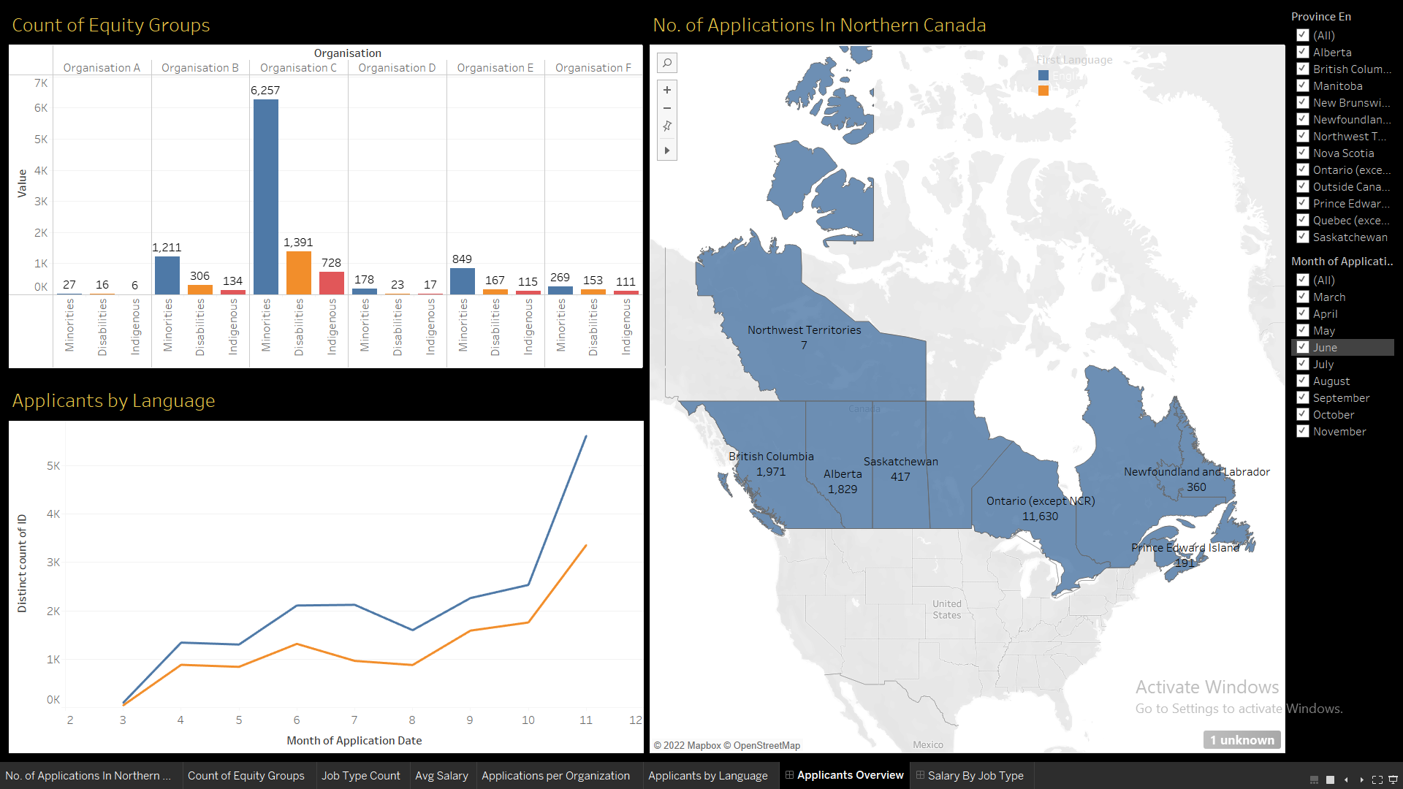
Overview of the Dashboard 1

Slide 9
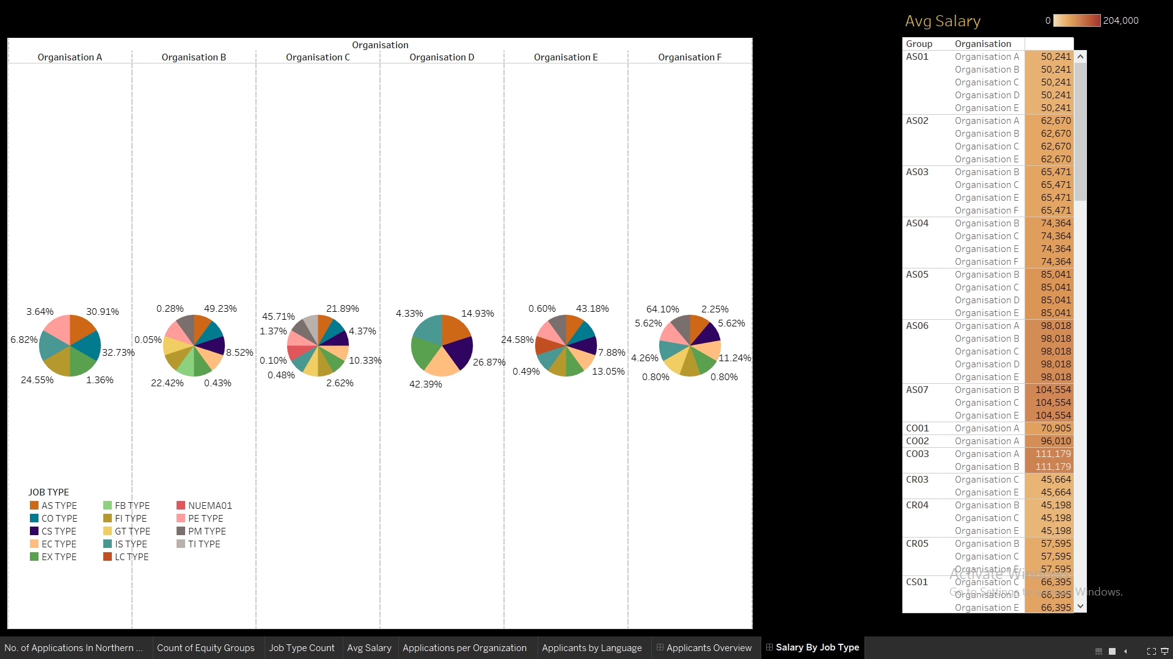
Overview of the Dashboard 2

Slide 10
THANK YOU

